Slide 1


Home Chef
Project Member:
Rasika Karde: 210543181036 Renuka Petkar : 210543181071 Archana Sapkal : 210543181091 Kavita Brahmankar: 210543181040

Slide 2
Objective:
Delivering good quality of food and services.
You can directly contact the chef and hire his services accordingly.
This is a project with the objective to develop a basic website where a consumer search best chef and hire them.

Slide 3
Functionality of the HomeChef
The Home Chef has three modules:
1. Admin Module:
Admin module is built to get exclusive insight of Chef as well as Customers reviews.
Interactive statistics makes it easy to understand the performance of the Chef.

Slide 4
2. Chef Module:
Chef module is useful for the advertisement of their dishes and Specialties.
Here Chef can display the different types of food made by him with its service charges and availability of him.

Slide 5
3. User:
User can view chef contact details according to his requirement.
User can view the chef’s special dishes and menu as well with price.

Slide 6
Flow of Application
User:
Dashboard page will be displayed to user which will display the Chef and its details.
From that page can User can click on the 'chefdetails' button and reach the chef details form page.
In the chef details page the User has to view specility of chef and hire chef and brief about the chef with image of the menu, chef etc.

Slide 7
Admin
Admin will login as Admin from the 'Admin login' page and will be able to see chef details filed . Admin Manage all chef details.

Slide 8
Chef:
Chef will login to the portal or will have to register if he is not a registered chef.
After registration chef will login and Dashboard page will be displayed to him which will display the Chef and its details.
From that page chef can click on the insert, Update and delete button for maintain his/her information and also menus .

Slide 9
Future Scope of Project:
We can add google map to search near by chef.
We can add chat with chef.
We can place order through website as well.
We can maintain user data through user registration and login.

Slide 10
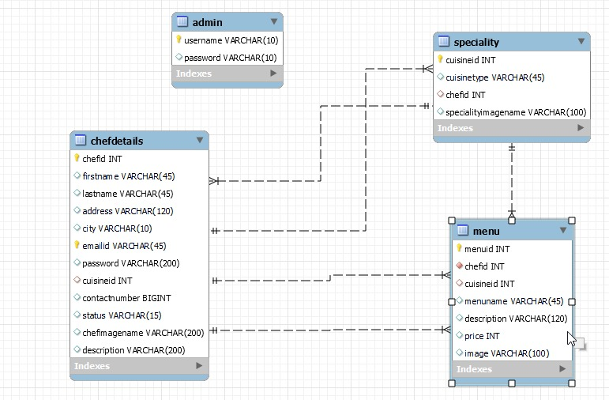
ER Diagram:
Manages

Slide 11
Table Structure
l. Table name: Admin
COLUMN NAME | DataType
username | varchar(10) PK
password | varchar(10)

Slide 12
3.Table name: Chefdetails
COLUMN NAME | DataType
Chefid | int AI PK
Firstname | varchar(45)
Lastname | varchar(45)
Address | varchar(120)
city | varchar(10)
emailid | varchar(45) PK
password | varchar(200)
gender | varchar(10)
contactnumber | bigint
status | varchar(15)
Cuisineid int fk
chefimagename | varchar(200)
Description | varchar(200)

Slide 13
4.Table name: menu
COLUMN NAME | DataType
menuid | int PK
chefid | Int fk
cuisineid | Int fk
menuname | varchar(45)
description | varchar(120)
price | int
image | Varchar(100)

Slide 14
4.Table name: Specialitiy
COLUMN NAME | DataType
cuisineid | Int pk
chefid | Int fk
cuisinetype | varchar(45)
Specialityimage name | Varchar(200)

Slide 15
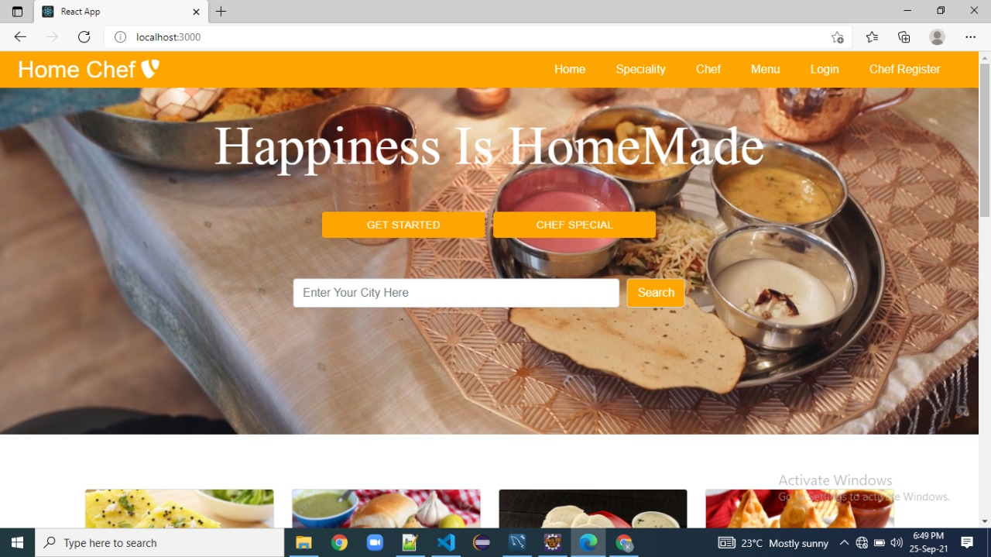
Home Page

Slide 16
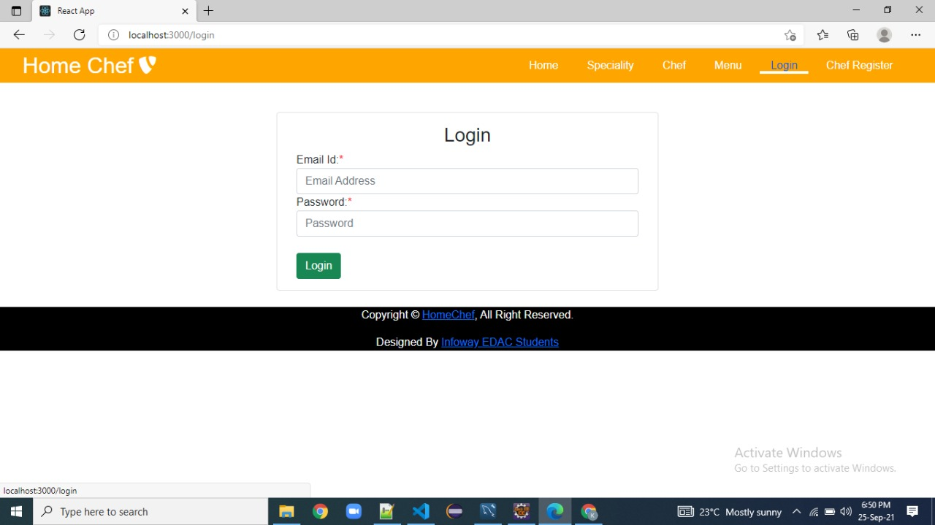
Login Page

Slide 17
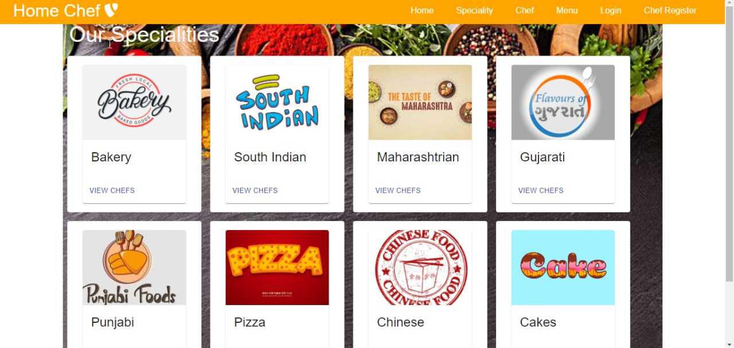
Speciality Page

Slide 18
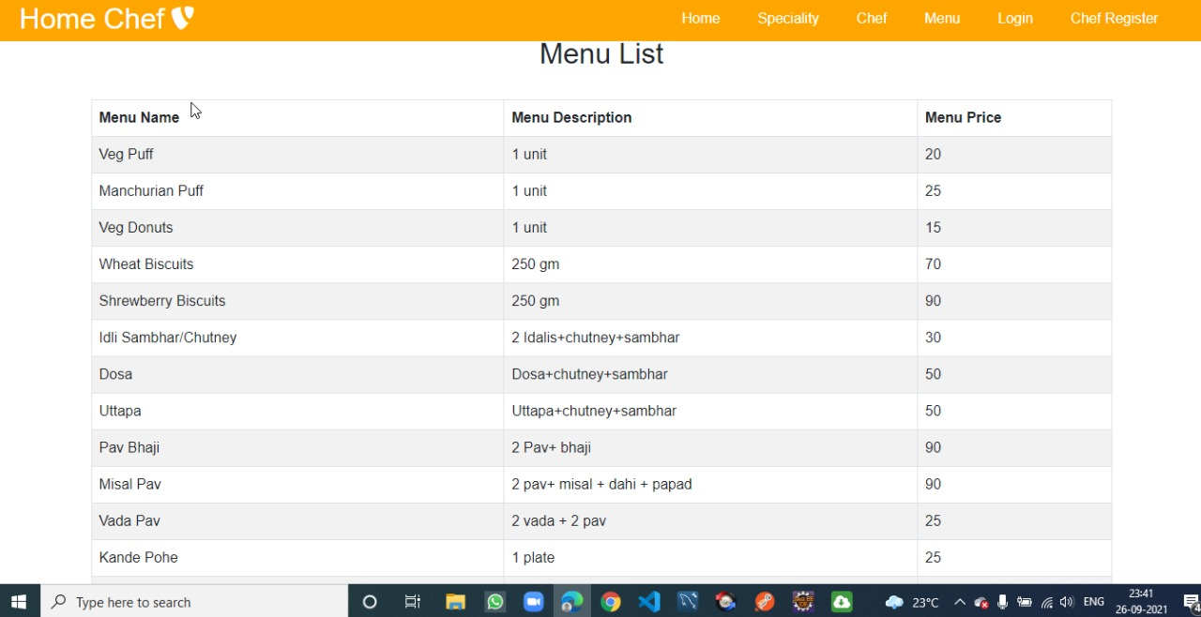
Menu Page

Slide 19
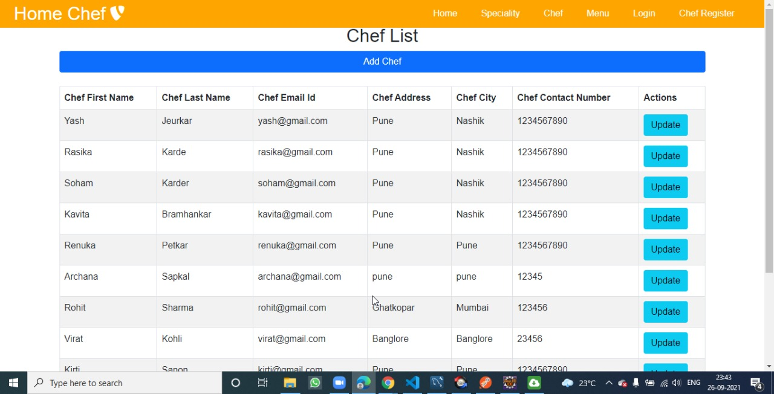
Chef Page

Slide 20


